Slide 1
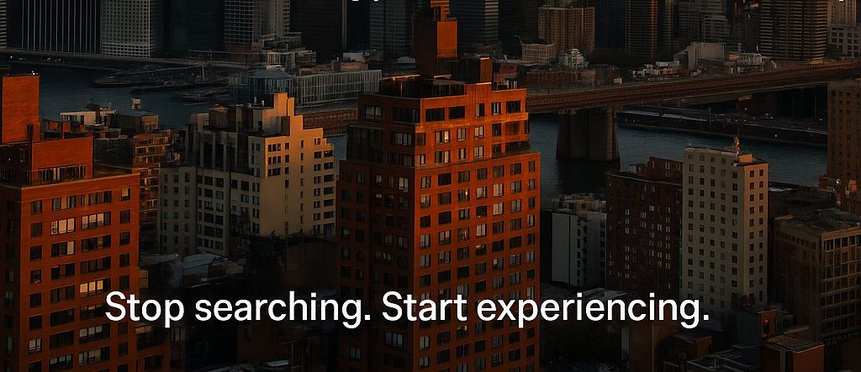

Cities Are Big. We Make Them Yours.
Brought to you by : Roshan Velpula | Irene SUNNY
Notes:
Cities are big. But your time — your taste, your interests, your lifestyle — your mood? That’s personal. We built a AI agentic solution to turn urban chaos into curated experiences.

Slide 2
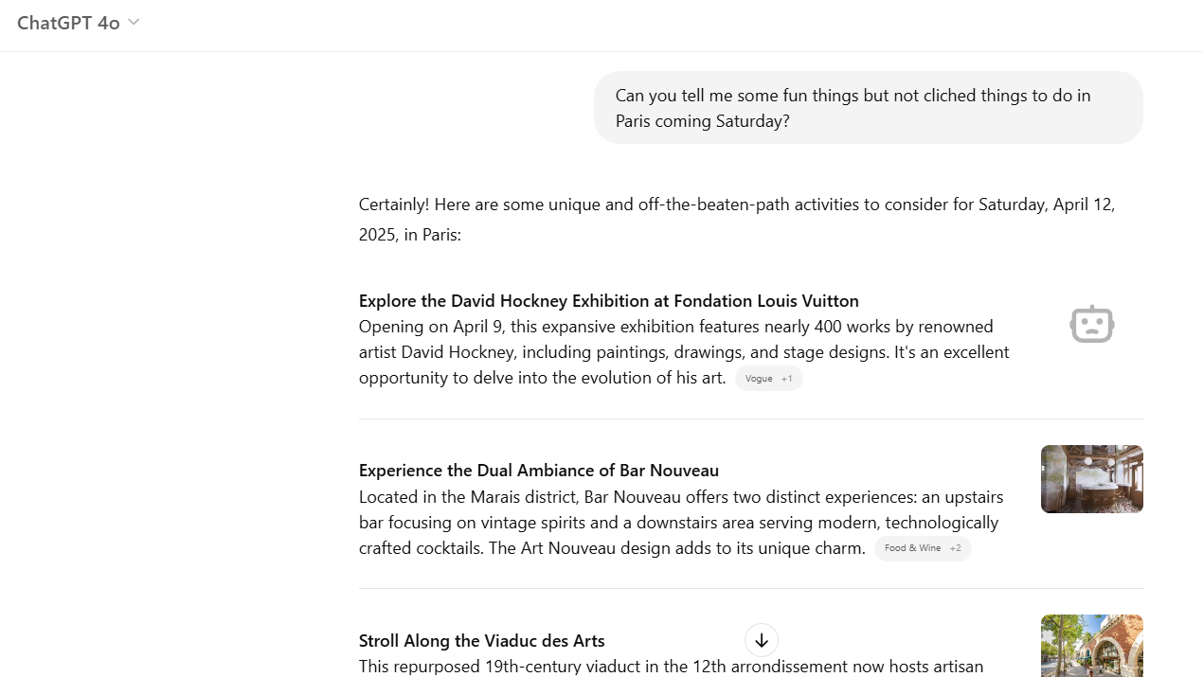
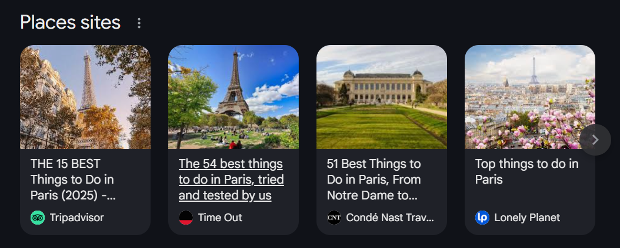
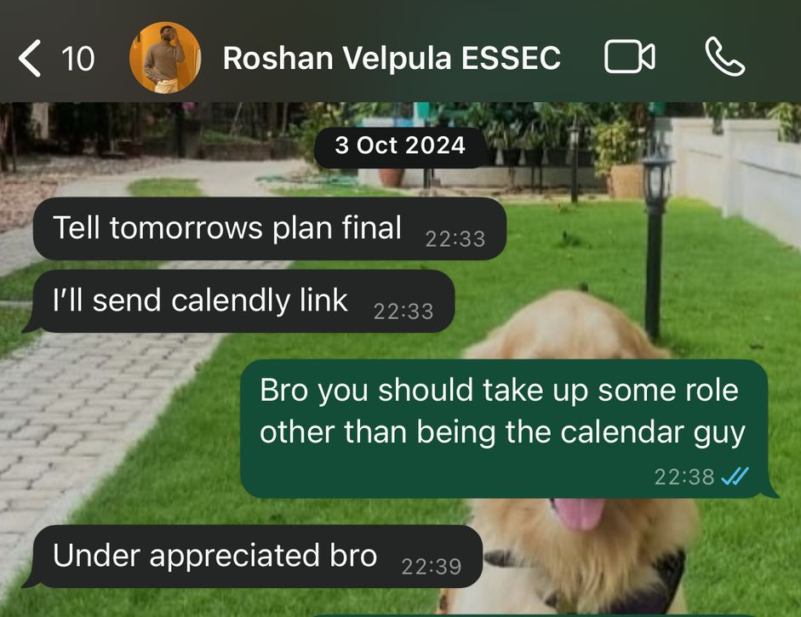
MOOD : It’s that moment when the calendar clears, the sun’s out, and the city calls.
Notes:
"City Scout starts with a moment we all know — your plans clear up, the sun’s out, and you want to do something, but have no idea what. So you ask Google or ChatGPT... and end up with the same touristy lists or generic suggestions. And in every group, there’s that one 'calendar friend' who always ends up planning. City Scout was built for that exact moment — to turn spontaneous intent into real, personalized action

Slide 3

SEARCH RESULTS BTS
(📍) Close to you
(🌟) Popular or well-reviewed Places
(💼) Well-optimized businesses
GOOGle’S local search results are optimized for advertisers MORE THAN for you as a person.
Notes:
“Your vibe, your calendar, your history, your preferences — all invisible to the current local search.”
“That’s why Google Maps feels like a helpful stranger — not a friend.”

Slide 4
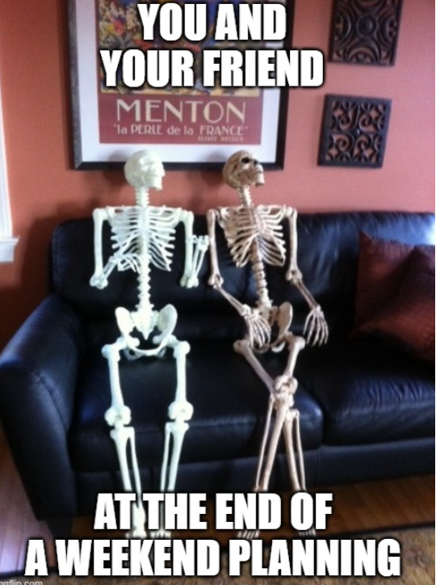
Notes:
“Your vibe, your calendar, your history, your preferences — all invisible to the current local search.”
“That’s why Google Maps feels like a helpful stranger — not a friend.”

Slide 5
“Finding something cool in the city shouldn't feel like homework.”
“I’m not a tourist — stop recommending the most obvious spots!”
“I just want one cool place that fits my vibe — not a top-10 list from 2018”
Notes:
Here’s the real frustration — exploring the city has become a chore. You get outdated lists, overhyped places, and one-size-fits-all suggestions. We’ve all said this: 'I'm not a tourist… just give me one spot that fits my vibe!' That’s exactly the gap City Scout fills.

Slide 6
CITY SCOUT
AI companion that knows who you are, where you are, and what you’d love to do right now.
hyper-personalized urban guide — it combines your interests, life style, personality, background, location, weather to suggest spontaneous experiences
Notes:
“Your vibe, your calendar, your history, your preferences — all invisible to the current local search.”
“That’s why Google Maps feels like a helpful stranger — not a friend.”

Slide 7
DEMO TIMe
(summoning all gods)
Notes:
“Your vibe, your calendar, your history, your preferences — all invisible to the current local search.”
“That’s why Google Maps feels like a helpful stranger — not a friend.”

Slide 8
Under the hood, we’ve built a smart chain of AI agents that analyse your persona – 3 LLMs to gather insights from google map activities, building user profile, picking places.
Notes:
“Your vibe, your calendar, your history, your preferences — all invisible to the current local search.”
“That’s why Google Maps feels like a helpful stranger — not a friend.”

Slide 9
71% of Millennials and Gen Z are willing to pay a premium for products and services that reflect their individuality and style
McKinsey & Company (2022)
Notes:
“Your vibe, your calendar, your history, your preferences — all invisible to the current local search.”
“That’s why Google Maps feels like a helpful stranger — not a friend.”

Slide 10
Hybrid Business Model
Freemium App (B2C) : Core experience is free. Premium tier offers features like saved journeys, calendar sync, deeper personality analysis. (~$3–5/month)
White-Labeled API (B2B SaaS) : Provide itinerary engine as an API for travel platforms, hotels, airports, or smart concierge apps.
Initial Launch Cities (Europe): Paris, Berlin, Amsterdam, Barcelona, Rome, Copenhagen
Primary Audiences:
Urban millennials & Gen Z professionals
INTERNATIONAL Students & digital nomads
Weekend travelers and solo explorers
Notes:
Launch as consumer-first, build engagement & data
Monetize via business integrations once personalization engine matures

Slide 11
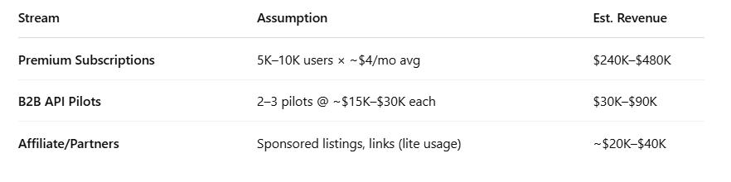
Market Sizing & Revenue Opportunity
Metric | Value (Estimate)
Total Urban Travelers in Europe (TAM) | ~200M annually (leisure & lifestyle explorers)
Targetable App Users (SAM) | ~25M in Tier-1 cities (tech-savvy, mobile-first)
Year 1 Goal (SOM) | 100K–200K engaged users in 6 cities
Conversion to Paid (5%) | ~5K–10K premium users
Year 1 Total Revenue Potential: ~$300K–$600K
Notes:
Launch as consumer-first, build engagement & data
Monetize via business integrations once personalization engine matures

